Slide 1
Auctions: A Lesson in Multiagent System Based on Jose Vidal’s book Fundamentals of Multiagent Systems
Henry Hexmoor
SIUC

Slide 2
Auction
Private value function = utility of owning an item.
Example: Gasoline
Common value function = resale value of an item.
Example: Stock share
Correlated value function = utility of an item derived from use + resale.
Example: A house

Slide 3
English Auction
First-price open-cry ascending
Initial/reservation price – min Value
Winner’s curse – common values are overbid

Slide 4
First-price Sealed-bid
It is a sealed envelope version of English auction

Slide 5
Dutch Auction
Open-cry descending price
Example: the Flower market in Antwerp

Slide 6
Vickrey
Second-price sealed-bid
Highest bidder pays second highest value.

Slide 7
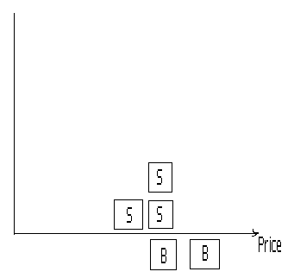
Double Auction
stock market
Clearing: value selling/buying, givedeals, keep profit

Slide 8
Auctions
Auctions are a common and simple way of performing resource allocation in a multiagent system.
In an auction, agents can express how much they want a particular item via their bid and a central auctioneer can make the allocation based on these bids.

Slide 9
Valuations
The notation to refer to the utility that agent derives from state . Similarly, if is instead an item, or set of items, for sale we can say that is the valuation that i assigns to .
Private value: valuation function reflects the agent’s utility of owning the given items.

Slide 10
Valuations
Common value : items which you cannot consume and gain no direct utility from but which might still have a resale value
Correlated value: function is very common in the real world with durable high priced items and lie somewhere in the middle.

Slide 11
Simple Auctions
There are times when there are many agents and the only thing they need to negotiate over is price. In these occasions it makes sense to use an auction since they are fast and require little agent communication.
The actual mechanisms used for carrying out an auction are varied. The most common of all is the English auction.
This is a first-price open-cry ascending auction.

Slide 12
Simple Auctions
These auctions sometimes have an initial or reservation price below which the seller is not willing to sell.
If an English auction is common or correlated value then it suffers from the winner’s curse.

Slide 13
open-cry descending price auction
A similar auction type is the open-cry descending price auction
In this auction First-price sealed-bid each person places his bid in a sealed envelope. These are given to the auctioneer who then picks the highest bid. The winner must pay his bid amount.

Slide 14
open-cry descending price auction
The Dutch auction is an open-cry descending price auction. In it the seller continuously lowers the selling price until a buyer hits a buzzer, agreeing to buy at the current price.

Slide 15
Vickrey auction
The Vickrey auction is a more recent addition and has some very interesting properties.
It is a second-price sealed-bid auction.
All agents place their bids and the agent with the highest bid wins the auction but the price he pays is the price of the second highest bid.

Slide 16
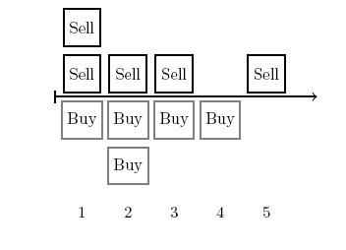
Graphical representation of a double auction

Slide 17
Double auction
Double auction is a way of selling multiple units of the same item.
Each buyer places either a buy or a sell order at a particular price for a number of instances of the item
Maximize the amount of surplus, known as the spread by traders. That is, the sum of the differences between the buy bids and thesell bids.

Slide 18
Analysis
Theorem 1 (Revenue Equivalence): All four single-item auctions produce the same expected revenue in private value auctions with bidders that are risk-neutral.

Slide 19
Analysis
A risk-averse bidder is willing to pay a bit more than their private valuation in order to get the item.
In a Dutch or First-price auction a risk-averse agent can insure himself by bidding more than would be required.
In common or correlated value cases the English auction gives a higher revenue to the seller.

Slide 20
Bidder collusion
In bidder collusion the bidders come to an a-priory agreement about what they will bid.
They determine which one of them has the higher valuation and then all the other bidders refrain from bidding their true valuation so that the one agent can get it for a much lower price.
The winner will then need to payback the others.

Slide 21
Analysis
The English and Vickrey auctions are especially vulnerable to bidder collusion as they self-enforce collusion agreements.
Another problem might be that a lying auctioneer can make money from a Vickrey auction.
A lying auctioneer can also place a shill in an English auction

Slide 22
Analysis
Shill: a decoy who acts as an enthusiastic customer in order to stimulate the participation of others.
Inefficient allocations: when auctioning items in a series when their valuations are interrelated it is possible to arrive at inefficient allocations.

Slide 23
Auction Design
When designing an auction for a multiagent system you must make many decisions.
You must first determine what kind of control you have over the system.
It is possible that you might control both agents and mechanism, as when building a closed multiagent system.
Currently all online auctions are implemented as centralized web applications.

Slide 24
Combinatorial Auctions
In combinatorial auctions, agents can place bids for sets of items instead of just placing one bid for each item for sale.
combinatorial auction over a set of items M as being composed of a set of bids, where each agent can supply many different bids for different subset of items. Each bid b is composed of , which is the set of items the bid is over, the . value or price of the bid, and which is the agent that placed the bid.

Slide 25
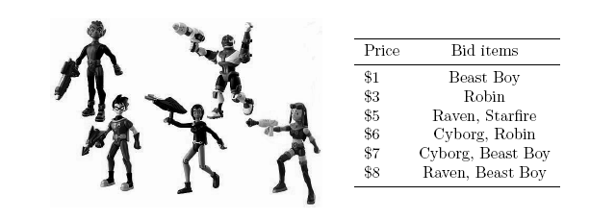
Combinatorial Auctions

Slide 26
Centralized Winner Determination
The winner determination problem is finding the set of bids that maximizes the seller’s revenue.
where C is a set of all bid sets in which none of the bids share an item, that is

Slide 27
Centralized Winner Determination
Stirling number of the second kind gives us the number of ways to partition a set of n elements into k non-empty sets.
Using this formula we can easily determine that the total number of allocations of m items is given by
which is bounded by

Slide 28
Centralized Winner Determination
Theorem 2: Winner Determination in Combinatorial Auction is NP-hard. That is, finding the X that satisfies (Theorem 1) is NP-hard.
Even simplifying the problem does not make it easier to solve. We call this the decision version of the winner determination problem.
Theorem 3: The decision version of the winner determination problem in combinatorial auctions is NP-complete, even if we restrict it to instances where every bid has a value equal to 1, every bidder submits only one bid, and every item is contained in exactly two bids

Slide 29
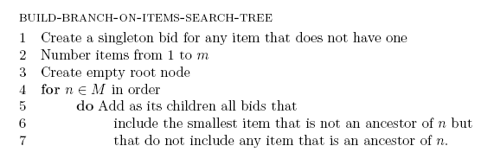
Build-branch-on-items-search-tree
Algorithm:

Slide 30
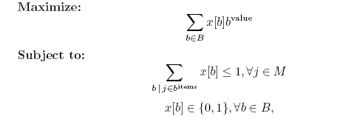
Centralized Winner Determination
The winner determination problem in combinatorial auctions can be reduced to a linear programming problem
The linear program which models the winner determination problem is to find the x that satisfies the following:

Slide 31
Centralized Winner Determination
The linear programming problem will solve a combinatorial auction when the bids satisfy any one of the following criteria:
1. All bids are for consecutive sub-ranges of the items.
2. The bids are hierarchical.
3. The bids are only OR-of-XORs of singleton bids.
4. The bids are all singleton bids.
5. The bids are downward sloping symmetric.

Slide 32
Centralized Winner Determination
Branch on items:
One way we can build a search tree is by having each node be a bid and each path from the root to a leaf correspond to a set of bids where no two bids share an item.
We refer to this tree as a branch on items search tree.

Slide 33
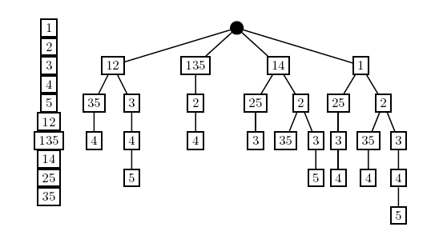
Branch on items

Slide 34
Centralized Winner Determination
Theorem 4: The number of leaves in the tree produced by build-branch-onitems- search-tree is no greater than (|B|/|M|)|M|. The number of nodes is no greater than |M| times the number of leaves plus 1.
We can also build a binary tree where each node is a bid and reach edge represents whether or not that particular bid is in the solution. We refer to this tree as a branch on bids search tree

Slide 35
Combinatorial Auctions
A branch and bound algorithm like the one we used for DCOP further helps reduce the search space and speed up computation. In order to implement it we first need a function ‘h’ which gives us an upper bound on the value of allocating all the items that have yet to be allocated

Slide 36
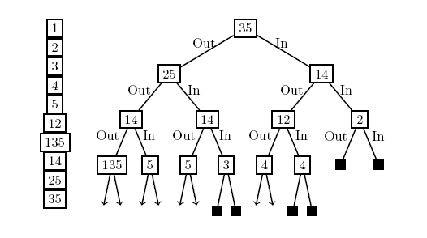
Combinatorial Auctions

Slide 37
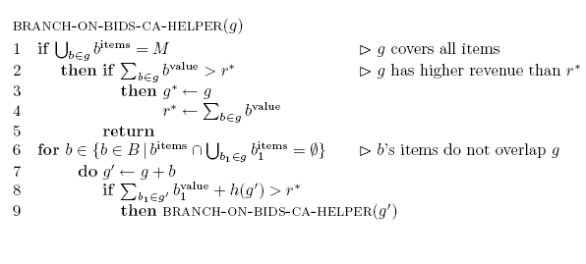
Combinatorial Auctions

Slide 38
Combinatorial Auctions
The Branch-On-Bids-Ca algorithm is the basic framework for the Combinatorial Auction Branch on Bids (CABOB) algorithm.

Slide 39
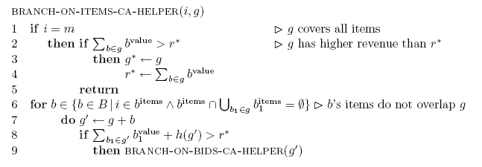
Combinatorial Auctions

Slide 40
Combinatorial Auctions
The branch and bound search on the branch on items search tree, This algorithm is the basis for the CASS (Combina-torial Auction Structured Search) algorithm which also implements further refinements on the basic algorithm.
The Combinatorial Auction Test Suite (CATS) can generate realistic types of bid distributions so new algorithms can be compared to existing ones using realistic bid sets.

Slide 41
Distributed Winner Determination
Incremental Auctions: Distribute over Bidders
One way to distribute the winner determination calculation is by offloading it on the bidding agents.
This is the approach taken by the Progressive Adaptive User Selection Environment or PAUSE combinatorial auction

Slide 42
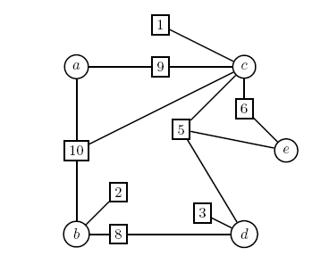
Pause

Slide 43
Distributed Winner Determination
Envy-free: The pause auction has been shown to be envy-free in that at the conclusion of the auction no bidder would prefer to exchange his allocation with that of any other bidder.
The Pausebid algorithm uses the same branch and bound techniques used in centralized winner determination but expands them to include the added constraints an agent faces.
VSA: Another way of distributing the winner determination problem among the bidders is provided by the Virtual Simultaneous Auction (VSA)

Slide 44
Distributed Winner Determination
Distribute over Sellers: Another way to distribute the problem of winner determination is to distribute the actual search for the winning bid set among the sellers.
Another option is to partition the problem into smaller pieces then have sets of agents to a complete search via sequentialized ordering on each of the parts.
Another option is to maximize the available parallelism by having the agents do individual hill-climbing

Slide 45
Winner Determination as Constraint Optimization
we can reduce the winner determination problem to a constraint optimization problem as described in two different ways:
One way is to let the variables x1, . . . , xm be the items to be sold and their domains be the set of bids which include the particular item.
The winner determination problem by letting the variables be the bids themselves with binary domains which indicate whether the bid has been cleared or not.

Slide 46
Bidding Languages
If b and b’ are two bids for non-overlapping sets of items then any agent that places them should also be happy to win both bids. This bidding language is known as or bids, because agents can place multiple atomic bids.
XOR bids, on the other hand, can represent all possible valuations. An XOR bid takes the form of a series of atomic bids joined together by exclusive-or operations:

Slide 47
Bidding Languages
One problem with XOR bids is that they can get very long for seemingly common valuations that can be more succinctly expressed using the OR bids.
Another practical problem with XOR bids is that most of the winner determination algorithms are designed to work with OR bids.

Slide 48
Preference Elicitation
Reduce the amount of information the bidders must supply by trying to only ask them about those valuations that are important in finding the utilitarian solution.
This can best be achieved in the common case of free disposal where there is no cost associated with the disposal free disposal of an item, that is, if
The goal of an elicitation auctioneer is to minimize the amount of questions that it asks the bidders while still finding the best allocation

Slide 49
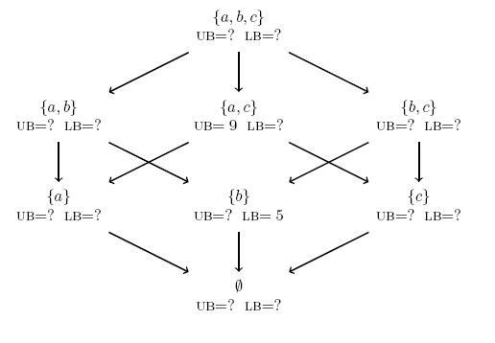
Preference Elicitation
.

Slide 50
Preference Elicitation
The PAR algorithm allows an elicitation auctioneer to find a Pareto optimal solution by only using rank questions.

Slide 51
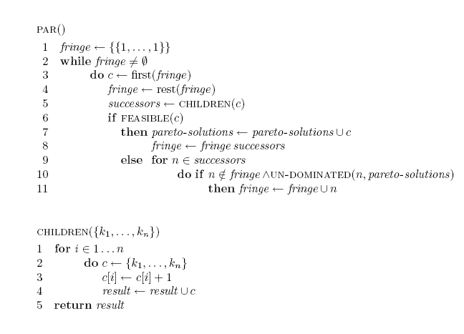
PAR algorithm

Slide 52
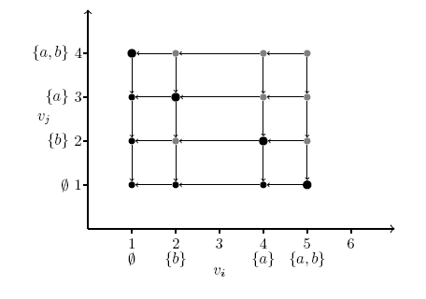
Rank lattice
.

Slide 53
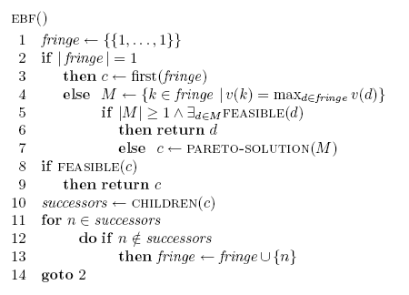
The EBF algorithm

Slide 54
EBF algorithm
The efficient best first (EBF) algorithm performs a search similar to the that PAR implements but it also asks for the values of the sets and always expands the allocation in the fringe which has the highest value.
Both par and EBF have worst case running times that are exponential in the number of items

Slide 55
VCG Payments
VCG payments can be applied to combinatorial auctions.
In a VCG combinatorial auction the bid set with maximum payment is chosen as the winner but the bidders do not have to pay the amounts they bid.
Instead, each bidder pays the difference in the total value that the other bidders would have received if he had not bid.
It increases the computational requirements as we now have to also solve a winner determination problem for every subset of n − 1 agents in order to calculate the payments.

