Slide 1
Dr. Henry Hexmoor Department of Computer Science Southern Illinois University Carbondale
Network Theory: Computational Phenomena and Processes
Characterizing Networks

Slide 2
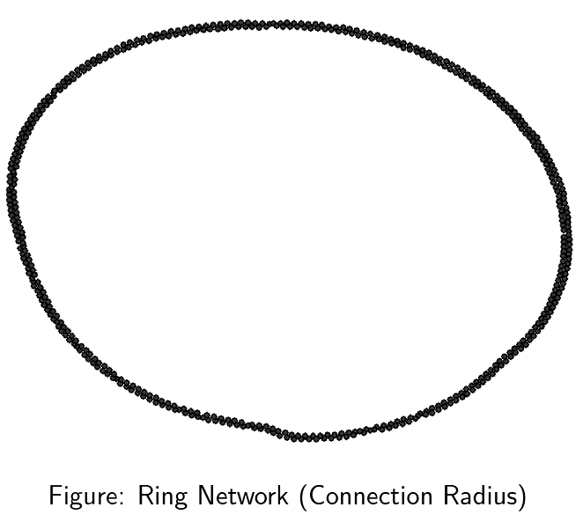
Ring Network Pseudocode
Initialize N nodes
For i=1 to N connect to people at Radius R to right to left, if tie does not already exist.
Note: Must deal with wrap-around.

Slide 4
Small-World(Watts-Strogatz) Network Pseudocode
Initialize N nodes
For i=1 to N connect to people at Radius R to right and left,
If tie does not already exist. (Still must deal with wrap-around.)
Check random number against Rewire Probability for each tie, and reconnect tie randomly if called for.

Slide 5
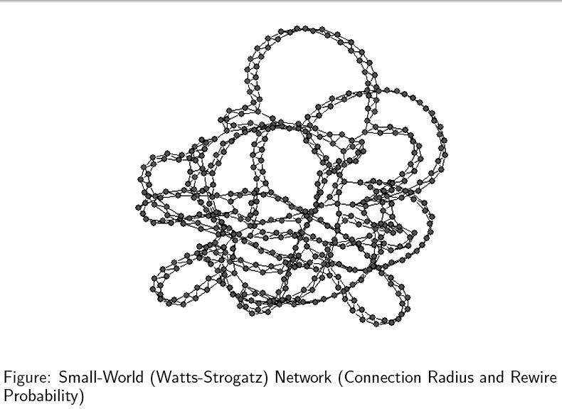

Slide 6
Village Network Pseudocode
Initialize N nodes
Split population into equally-sized subsets of size Village Size; odd individuals get lumped in smaller village.
Make all possible connections within villages.
Make ties to people outside of villages with probability Far Probability.

Slide 7
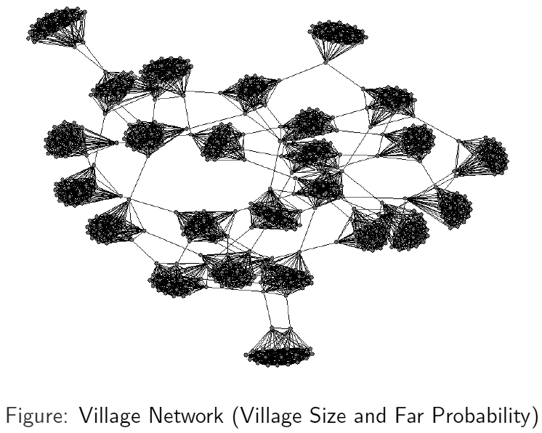

Slide 8
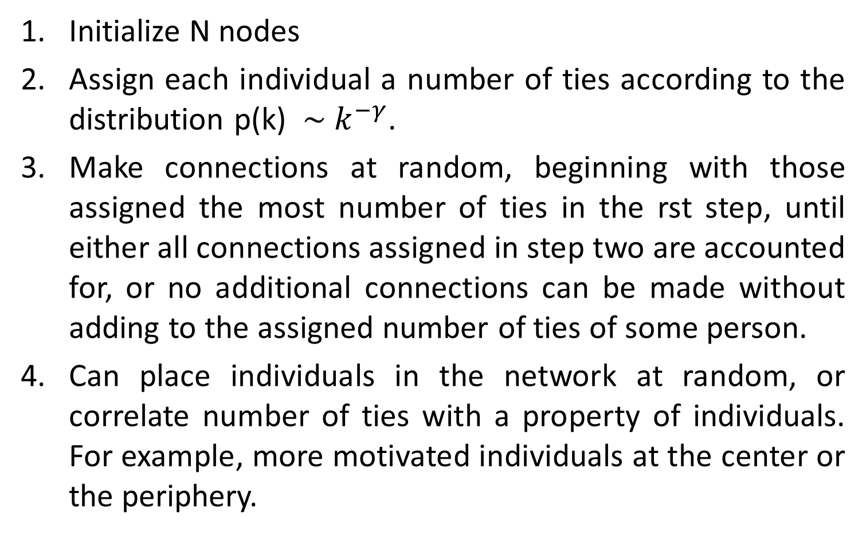
Scale-Free (Opinion-Leader) Network Pseudocode
Initialize N nodes
Assign each individual a number of ties according to the distribution p(k) $\sim k^{−γ}$.
Make connections at random, beginning with those assigned the most number of ties in the rst step, until either all connections assigned in step two are accounted for, or no additional connections can be made without adding to the assigned number of ties of some person.
Can place individuals in the network at random, or correlate number of ties with a property of individuals. For example, more motivated individuals at the center or the periphery.

Slide 9
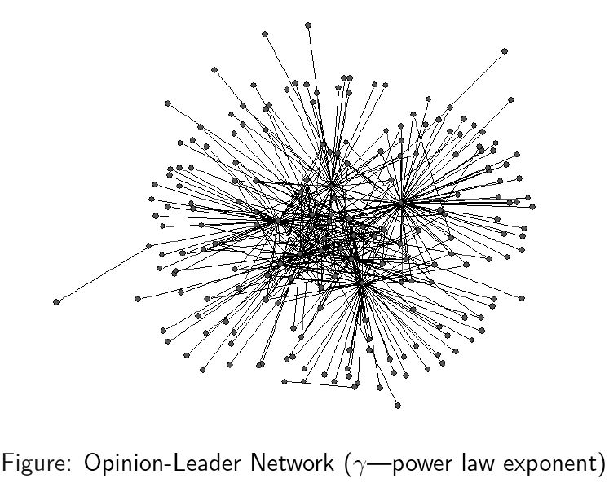

Slide 10
Hierarchical Network Pseudocode
Initialize N nodes
Create the skeleton of the hierarchy according to Expansion Rate. One individual is placed at the top, and each individual in the network is connected to a number of individuals below her equal to Expansion Rate, continuing until no more individuals are left in the population.
Make ties to people in same level with probability Level Connection.
Can assign individuals at random, or correlate places in hierarchy with a property of individuals.

Slide 11
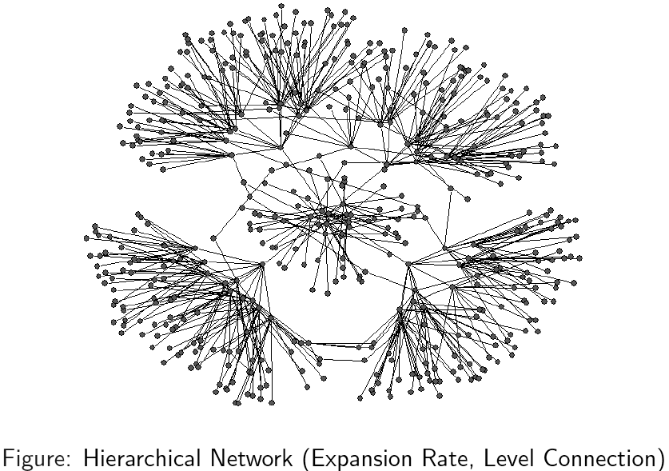

Slide 12
The degree to which a vertex dominates other vertices
L= leadership
$D_{i}$ = degree of node i
$d_{max}$ = highest degree of nodes in the network
L= $x=\frac{\sum_{i=1}^{n}{d_{max} −d_{i} }}{\left(n−1\right)(n−2)}$

Slide 13
Bonding = B = a clustering coefficient
B= $\frac{6 ∗\# triaingles}{\# length −two paths}$
Diversity= D =$\sqrt{\frac{\# disjoint dipoles}{{\left(\left(\frac{1}{n}∗\frac{n}{2}\right)\left(\frac{n}{2}−1\right)\right)}^{2}}}$

Slide 14

Normalized Measures
L= $\frac{L}{L+B+D}$
b = $\frac{B}{L+B+D}$
d = $\frac{D}{L+B+D}$
r = L${(\frac{B}{D})}^{2}$
B=1
Clique
Ring
Star
D=1
L=1

