Slide 1
Network Theory: Community Detection
Dr. Henry Hexmoor Department of Computer Science Southern Illinois University Carbondale

Slide 2
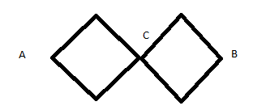
Community Definition
A community is a subset of nodes in the network that form a cohesive group. In order to discover how to detect communities in a network it is essential that to understand what a vertex cut set is, which is set of vertices whose removal disconnects the network; thereby laying the foundational step in detecting communities. Let us consider the following network:
{C} is the minimum vertex cut set in accordance with the above network. Three community detection algorithms are explained the following slides:
A global algorithm (Kernighan and Lin, 1970)
Spectral Partitioning
Girvan - Newman Algorithm

Slide 3
A GLOBAL ALGORITHM (Kernighan and Lin, 1970)
Divide network vertices into two groups of input size in some way, including randomly
For each pair (i, j) of vertices such that i is in one and j is in the other group, compute change in the cut set by an interchange between i and j (keeping their neighbors but move to the other group). Among all pairs (i, j), find the pair whose interchange would reduce the cut set the most. Swap that pair
Repeat step 2 making sure interchange is non-repeated for a pair of nodes
After all possible swaps are complete, the obtained result is the best network position in terms of communities

Slide 4
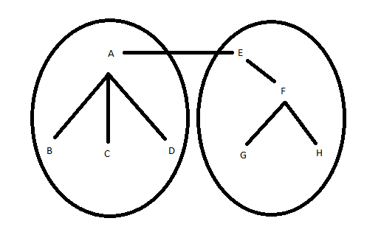
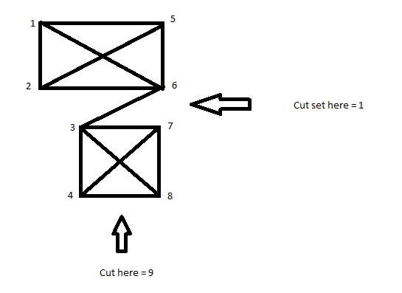
Example 1:
Example 2:
If A and E are swapped,
A adds three to cut set
E adds one to cut set
Therefore, this is a bad swap

Slide 5
SPECTRAL POSITIONING
Consider a graph, G(|n|, |m|)
Divide G into groups 1 & 2
R = Number of edges between groups 1 & 2 = ½∑Aij (I & j belong to different groups)
S = +1 if i ∈ group 1
-1 if i ∈ group 2
Kronecker Delta, ∂ij = ½ (1 – SiSj) = 1 if I & j ∈ different groups
ø if I & j ∈ same group
R = ¼
R = ¼ ∑ (Kij ∂ij - Aij) . SiSj
Where (Kij ∂ij - Aij) is the ijth laplacian matrix = Lij
Ki = = degree of I
R = ¼ S^{T} L S (where S is the vector with elements Si)
In general, given A, D = diagonal matrix (degree of nodes along the diagonal)
Laplacian, L = D - A

Slide 6
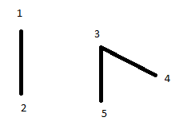
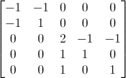
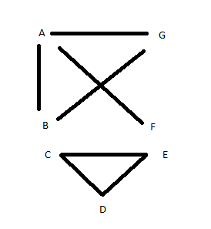
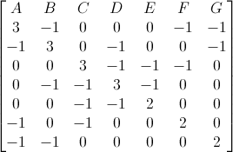
Example 1
Example 2
L =
L =
Expected edges between I & j in a random network = (kikj)/2m
Q = modularity = (1/4m) = ∑ (Aij – ((kikj)/2m)) SiSj
= (1/4m) S^{T} B S
B is the modularity matrix Bij = (Aij – ((kikj)/2m))

Slide 7
Girvan and Newman Algorithm
Compute betweenness for all existing edges in the network
Remove the edge with the highest betweenness
Recompute all edge betweenness values
Repeat steps 2 & 3 until no edges remain
-- The remaining connected components are the communities

Slide 8
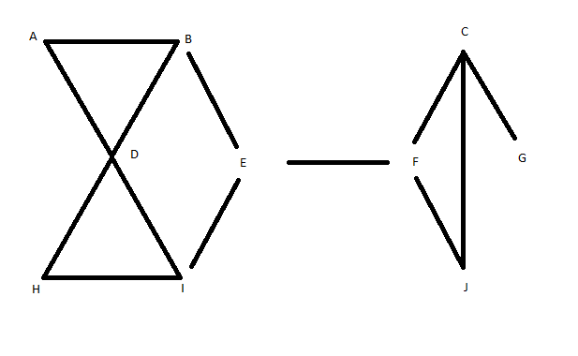
Example

Slide 9
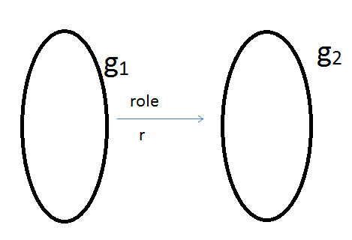
Positional Roles Analysis (1/4)
There are times when we can group nodes who relate to other groups of nodes in a specific manner; e.g., employer- employee; teacher- student ; father –son
Consider groups 1 and 2.

Slide 10
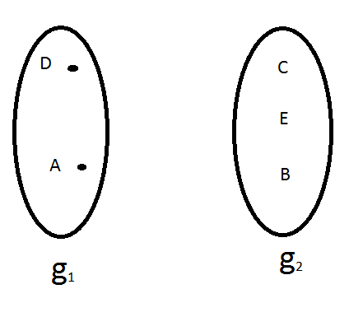
Positional Roles Analysis (2/4)
i.e. . The role is used for grouping.
Step 1: Find structurally equivalent nodes.

Slide 11
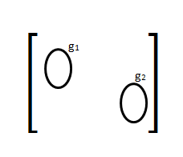
Positional Roles Analysis (3/4)
Step 2: Search for nodes that can be assigned to positions in groups from step 1.
In an adjacency matrix, position (i.e., groups) can be seen as blocks.

Slide 12
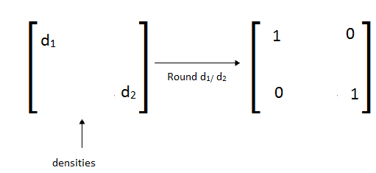
Positional Roles Analysis (4/4)
Step 3: Reduction – compute densities in blocks and if larger than a threshold, round up/ down to an image matrix:

Slide 13
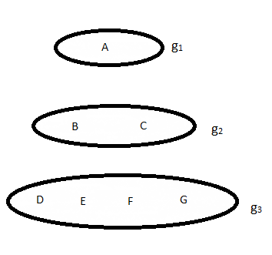
Other equivalence groupings…
An alternative sets of node equivalence ( White Retiz, 1983) This is non . proximity based.

Slide 14
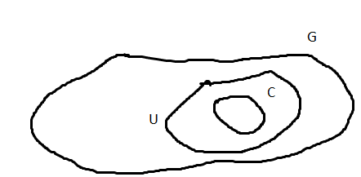
Local Community Detection (1/4)
Community Detection Cont’d – Local ( clauset, 2005) Consider a graph G, with C G about which we know all connections neighbors of C is U.

Slide 15
Local Community Detection (2/4)

Slide 16
Local Community Detection (3/4)
Next, we define boundary of C being B.
I = Interior
T = Terminal

Slide 17
Local Community Detection (4/4) A Greedy Algorithm
Add v0 to C
Add all neighbors of v0 to U
Set B= v0
While | C | < K do
For each v_{j} ∈ U do
Compute
End for
Find V_{j} such that is maximum
Add that V_{j} to C
Add all new neighbors of that V_{j} to U
Update R and B
End while

Slide 18
Changes in Local modularity
x = # of edges in T that terminated at V_{j}
y = # of edges that will be added to T by agglomeration of V_{j}
z = # of edges that will be named from T by agglomeration.

