Slide 1
Network Theory: Computational Phenomena and Processes Institutions
Dr. Henry Hexmoor Department of Computer Science Southern Illinois University Carbondale

Slide 2
Institutions
A set of rules and norms that guide collective action.
E.g: The stock exchange
Consider Braess’s Paradox
- Braess Researched road traffic and found counter intuitive results. Consider the following routes
X= number of cars traveling the path
C
X/100
45
A
B
45
X/100
D

Slide 3
Traffic Example
e.g.
X= 4000 =T1
4000/100+45=85min =T1 ( Travel time from A to B)
If cars chose paths such that each path carries 2000 cars only
then, 2000/100+45= 65min= T2 (Travel time from A to B)
Suppose a new bridge is added that
connects C to D.
If everyone used the bridge,
Then, 4000/100+0+4000/100=80min=T3
Paradox T3>T2
Individuals expected others to use the bridge
So they did as well.
C
X/100
45
A
B
45
X/100
D

Slide 4
Exogenous vs. Endogenous factors
Unknown desirability of alternatives
Exogenous : Value Independent of others
Endogenous : Value dependent on others choices
Exogenous events in Markets
Prediction markets create a collective opinion by coalescing opinions of a group about a future event.
E.g : Iowa electronic markets to forecast 2008 presidential election results.
Price= Average of beliefs about a event probability.
Market= An institution that aggregates positions of its consistent
members

Slide 5
Voting Systems
Voting Systems produce collection action
We must aggregate subjective preferences among a group.

Slide 6
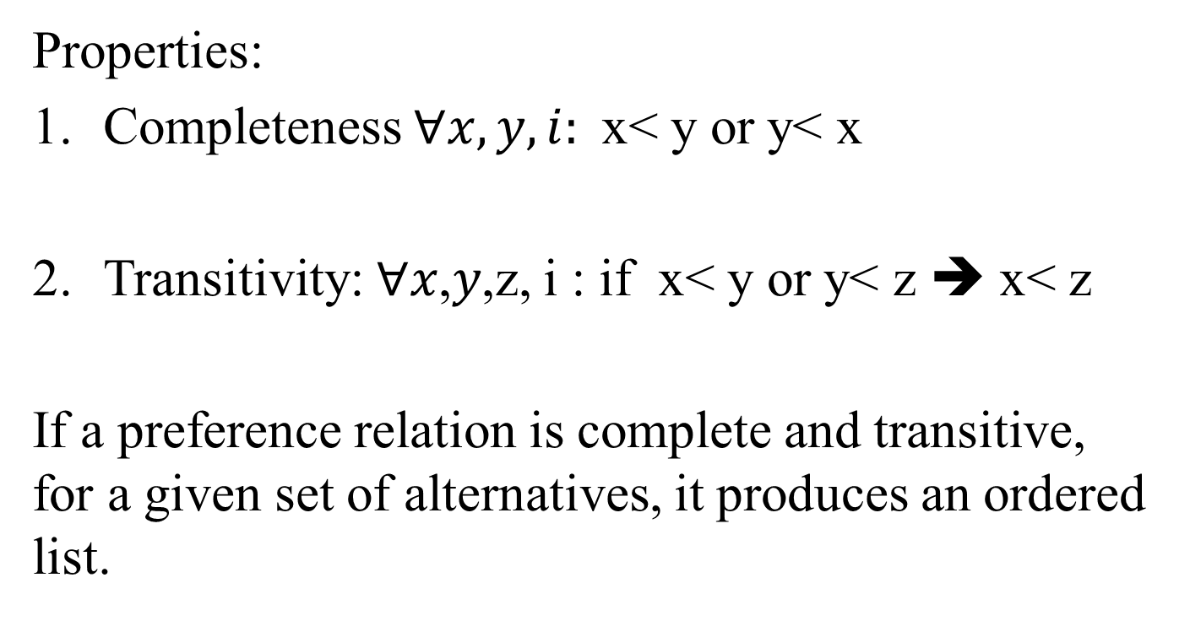
Voting System Cont’d
Properties:
Completeness $∀x,y,i:$x< y or y< x
Transitivity: ∀𝑥,𝑦,z, i : if x< y or y< z ➔ x< z
If a preference relation is complete and transitive, for a given set of alternatives, it produces an ordered list.
i
i
i
i
i

Slide 7
Majority Rule
Assume an odd number of voters and for a pair of alternatives, sum votes for each and the maximum votes selects its fair choice.

Slide 8
Condorcet Paradox
A voting paradox noted by the Marquis de Condorcet in an essay published in 1785. For example, suppose there are three candidates, A, B, and C, and three voters whose preferences are as follows:
Preference
First Second Third
Voter 1: A B C
Voter 2: B C A
Voter 3: C A B
A is preferred to B by a majority of voters and B is preferred to C by a majority. However, it is also the case that C is preferred to A by a majority.

Slide 9
Condorcet Paradox (Ex.2)
3 voter 1,2,3 and 3 alternatives x,y,z.
x> y > z By Majority x>y : 2 votes
y> z > x y>z : 2 votes
z> x > y z>x : 2 votes
Transitivity is violated
Majority Rule is problematic in several aspects
1
1
2
2
3
3

Slide 10
Borda Count
With k alternatives, voter i gives k-1 to her prior choice, k-2 to her 2nd, and so on. Alternatives are ordered based on sum of this weights gives by voters
Borda Count suffers from pathological as well
Arrow’s impossibility theorem: Proves there isn’t a voting system free from pathology.

Slide 11
Single peaked preference
A preference that clearly identifies top candidate at the peak.
ranking
Top candidate
alternatives

Slide 12
Single peaked preference (Cont.)
Proposition: If all individual ranking are single peaked, then majority rule applied to all pairs of alternatives produce a preference relation that is complete and transitive.

Slide 13
Median Favorite
Let’s have individual voters each have an ordered list of candidates. Find the candidate that is at the median of all ordered lists.
Theorem: the median candidate defeats every other alternatives in pairwise majority vote.

Slide 14
Markets as Institutions
The following holds in a market equilibrium:
The value of consumer good > the cost of consumer good
Goods are assigned to consumers who value them the most. This is evident in prices paid for goods.
Total consumer good value -Total good cost = Social surplus from property rights.

Slide 15
Markets as Institutions
Externality occurs when these are social surpluses beyond the ones from property right. It can be positive, benefiting same people; e.g, technological advances helping quality of life for all people.
It can be negative for some people; e.g, Apple products negatively affecting Asian workers.

Slide 16
Markets as Institutions
Consider a restaurant as an example:
A consumer buy $5 smokes a cigar.
Another consumer suffers $10. If benefit beyond cost is $5;
benefit=$15
surplus=$15-$10=$5

Slide 17
Markets as Institutions
There are several alternative for compensation. There are problems arising from each.
Pay the consumer for her suffering
Convert “smoke free air” in the restaurant into a commodity to be traded
Pass a law prohibiting public smoking.

Slide 18
Markets as Institutions
Tragedy of commons—sharing a common resource

Slide 19
John Coase’s Theorem using on example:
Markets as Institutions
Consider a baker and a doctor who share an office building.
Problem: baker’s machinery disturbs the doctor’s medical practice who is responsible for externalities.

Slide 20
Markets as Institutions
Baker can buy quieter machinery for $50. Doctor can sound proof for $100.
Scenarios:
Town assigns property rights of noise to doctor so he forces baker to spend $50.
Town assigns prop rights if noise to baker. So doctor pays 50$ to baker to buy machinery.

Slide 21
Markets as Institutions
Theorem: If property rights are complete and transaction cost is zero. The parties will always negotiate an efficient solution to the externality.
Therefore, the market will solve externalities by itself unless:
Property rights are incomplete (e.g; clean air in the restaurant), or
Negotiation among parties is costly

