Slide 1
Interactions in Networks In part, based on Chapters 10 and 11 of D. Easly, J. Kleinberg, 2010. Networks, Crowds, and Markets, Cambridge University press.
Dr. Henry Hexmoor
Computer ScienceDepartment Southern Illinois University
Carbondale, IL 62901
Hexmoor@cs.siu.edu

Slide 2
Social Balance Theory (Heider, 1946):
2
Consider relationships among three nodes 1, 2, 3
+ denotes friendships
- denotes enemies
1
3
1-2 | 1-3 | 2-3
+ | + | + | BALANCED
+ | + | - | IMBALANCED
+ | - | + | IMBALANCED
+ | - | - | BALANCED
- | + | + | IMBALANCED
- | + | - | BALANCED
- | - | + | BALANCED
- | - | - | IMBALANCED

Slide 3
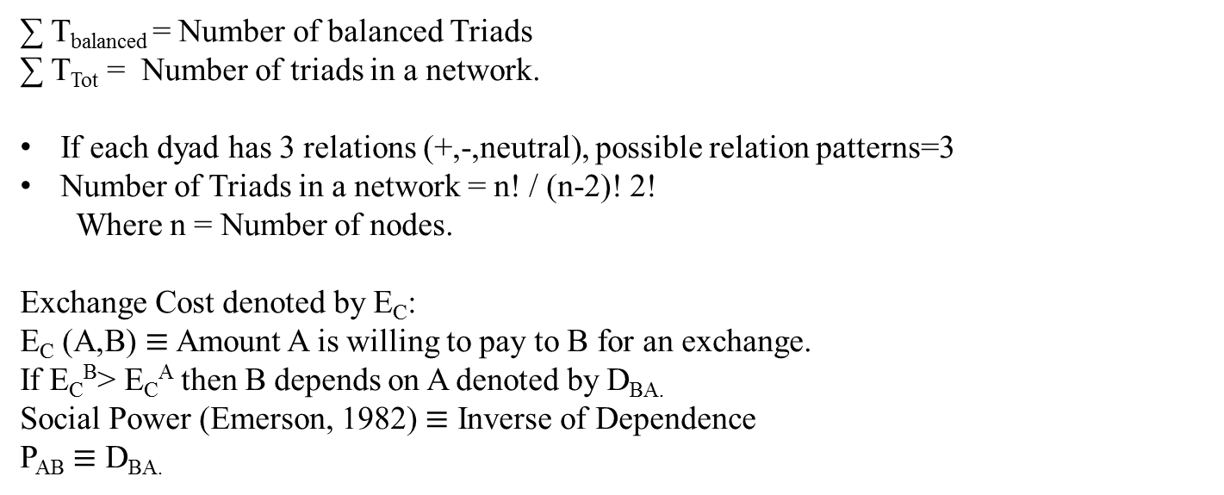
Global Balance Index (β) $≡$∑ T_{balanced} / ∑ T_{Tot}
∑ T_{balanced} = Number of balanced Triads
∑ T_{Tot} = Number of triads in a network.
If each dyad has 3 relations (+,-,neutral), possible relation patterns=3
Number of Triads in a network = n! / (n-2)! 2!
Where n = Number of nodes.
Exchange Cost denoted by E_{C}:
E_{C} (A,B) $≡$ Amount A is willing to pay to B for an exchange.
If E_{C}^{B}> E_{C}^{A} then B depends on A denoted by D_{BA.}
Social Power (Emerson, 1982) $≡$ Inverse of Dependence
P_{AB} $≡$ D_{BA.}

Slide 4
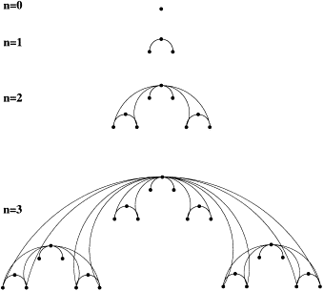
Albert Barabasi Network Building Algorithm (2001)
Construction Of a Deterministic Scale Free Network
0. Start from a single node, root of graph.
Add 2 nodes to root.
2. Add 2 units of 3 nodes from step 1.
3. Add 2 units of 9 nodes each from step2.
.
.
.
.
.
n. Add 2 units of 3^{n-1} nodes from step n-1.
r

Slide 5
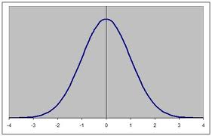
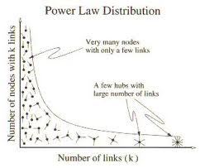
Constructing a Random Network
∀ i,j ϵ N, P(i,j) = The probability of tie between nodes i and j can be set to a probability parameter.
A random network has uniform degree distribution where as a scale free network has a
Power law degree distribution.
Number of nodes with k Ties
Frequency
Of K ties
1
2
K degrees
Degree distribution in a random Network
Degree distribution in a scale free network
20-80 Rule: 20% have 80% Ties.

Slide 6
Two Erdos-Renyi Models Of Random Networks
G(n,M) = A Network is randomly chosen from all graphs with “n” nodes and “M” edges.
e.g: G(3,2)
B
B
B
1/3 probabiliy
A
C
A
C
A
C
2. G(n,p) = Each edge is included in the graph with probability P independent from every
Other edge.
If P > log n/n Then Network is connected with probability trading to 1.
If P < logn/n Then Network is not connected with probability trading to 1
If a component has fewer than n^{3/2}/2 nodes, it is small.
If a component has a least n^{2/3}/2 nodes, it is large.

Slide 7
Giant Component $≡$ The unique largest component.
Clustering Coefficient $≡$ Degree to which nodes cluster together.
C_{i}^{local} $≡$ Number of pairs of neighbors of i that are connected
Numbers of pairs of neighbors of i
C^{overall} $≡$ (Number of triangles) * 3
Number of connected Triples
Triples: Three nodes that may or may not be a triangle
Theorem (Erdos, 1961): A threshold function for the connectedness of the poisson random network is t(n) =log(n)
n

Slide 8
MATCHING MARKETS:
Consider a bipartite graph:
Category 1
Category 2
Students
Rooms in a dorm
Perfect Matching $≡$ Assignment of all nodes in a bipartite graph.
N(S) = Neighbors of S = Collection of all neighbors of set S in the other category.
S
N(S)
If |s| < N(s) then S is Constricted.
I.e., If there exists a constricted set then there does not exist a Perfect Match.

Slide 9
Matching Theorem:
If a bipartite graph has no perfect matching then it must contain a constricted set.
Valuation = If each person i on the left assigns a value to items in the right, then
We will have a valuation vector
Any Actual Assignment will have a value.
∀ i ∈L,J ∈R, ∑ (J) = i’s value for j.
(J ∈ match)
Market Clearing:
i
i
House Buyers
House Sellers
V_{ij} = valuation of i for j
P_{i} = selling price for seller i

Slide 10
If Payoff_{j} > 0 then seller I are preferred sellers for j
If Payoff_{j} < 0 , buyer j may cancel transaction and not buy.
MARKET CLEARING:
Market Clearing is a set of prices such that each house is bought by a different buyer.
Examples are given below.

Slide 11
prices
sellers
buyers
valuations
5
a
x
12,4,2
2
b
y
8,7,8
c
z
7,5,8
0
An example for Non-Market Matching:
prices
sellers
buyers
valuations
x
12,4,2
2
a
y
8,7,6
1
b
0
c
z
7,5,2

Slide 12
Need For Buyer Coordination: Y & Z Must coordinate i.e Swap
Prices
Sellers
Buyers
Valuations
2
a
x
12,4,2
1
b
y
8,7,6
0
c
z
7,5,2
Existence Principle = ∀ Set of valuations, there exists a set of market clearing prices.
Optimality Principle = ∀ Market clearing prices, a perfect matching has maximum total
Valuation of any assignment for buyers and sellers.

Slide 13
Constructing a set of Market Clearing Prices:
At the start of each round, there is a current set of prices, with the smallest one
Equal to 0.
Construct the preferred-Seller graph and check whether there is a perfect Matching.
If there is, We are done: The current prices are market clearing.
If not, We find a constricted set of buyers S and their neighbors N(S).
Each Seller in N(S) simultaneously raises her price by one unit.
If necessary, We reduce the prices- The same amount is subtracted from each price
so that the smallest price becomes zero.
7. We now begin the next round the auction, using these new prices.

Slide 14
Interactions mediated with Intermediaries…

Slide 15
Intermediaries are used in the stock market.
Order Book = A list of buyer and seller orders for stocks.
Limit Orders = Conditional buy or sell
e.g. Buy 100 shares if price > $3/share.
Bid = The highest outstanding order to buy the stock.
Ask= The lowest outstanding order to sell the stock.
Market Order = Orders to trade immediately at market price.
Walking Up/ The book down = Successive orders for the order book issued.
Dark pool orders = Multiple orders for large buy and sell not open for the public.
A MODEL OF TRADE:
There exists a single type of good in individual units.
V_{i} = i’s value of good for seller.
V_{j} = j’s value of good for buyer.

Slide 16
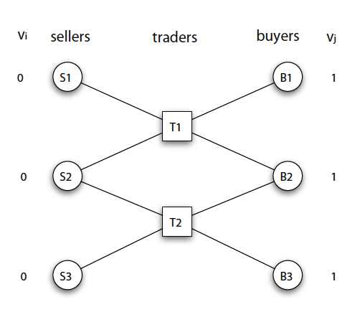
A Typical Network:
Traders set prices to which buyers and sellers react.
b_{tj} = t sets a bid price for seller i.
a_{tj} = t sets an ask price for buyer j.

Slide 17
After traders fix prices, each buyer and seller select a trader for deals.
A trader who defaults on an after to sell to a buyer will receive a large penalty.
Indifference = Indifference between accepting or rejecting shown by equality of valuations.
V_{s}
V_{s}
V_{B}’
V_{B}’
B
S
T
Tie braking is performed by setting artificial values of 0.01 and 0.99
Trading Payoff = ∑ Ask Prices accepted by sellers - ∑ Bid prices accepted by buyers.
Buyer Payoff = b_{ti.}
Buyer Payoff = V_{j} - a_{tj}.

Slide 18
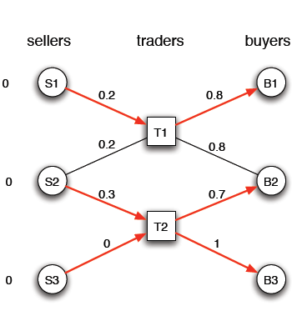
e.g. Value Sellers traders Buyers value.
Pay Offs:
Buyers
Sellers
Trades
1- 0.8 = 0.2
0.2
0.8-0.2 = 0.6
1- 0.7 = 0.3
0.3
0.7 + 1 – 0.3-0=1.4
1 – 1 =0
0

Slide 19
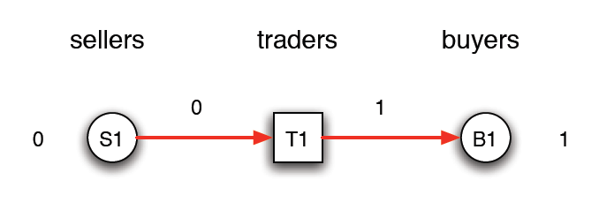
Two stages for Trade:
1. Traders set Prices Simultaneously.
2. Buyers and sellers choose trades and pick best offers simultaneously.
Traders know buyers and sellers will choose best responses; Therefore, set prices such
That they will attract them for deals.
This is a sub game perfect equilibrium (SPE).
MONOPOLY:
Monopoly = When buyers and sellers have a forced deal with a trader.
e.g.

Slide 20
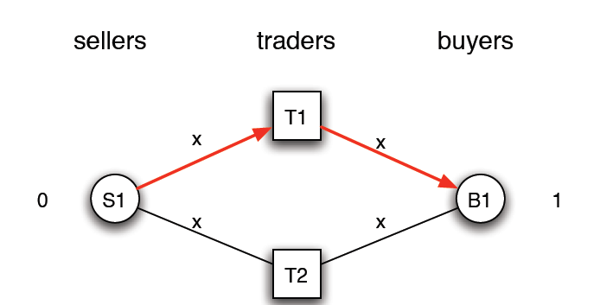
Perfect Competition
To avoid lasing to T₂ , T₁ must ask and bid at X – 0.01 / ε
Therefore equilibrium for T₁ is 0; Fore go Profit to attract a deal.

Slide 21
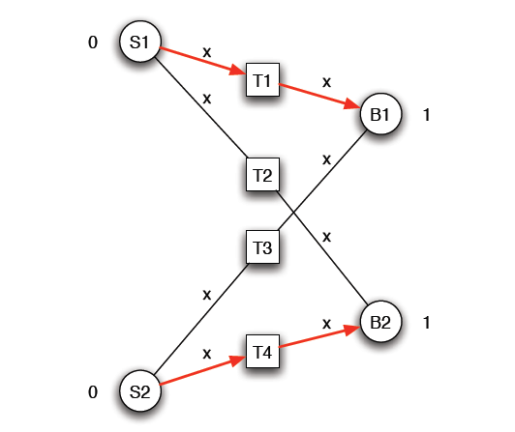
IMPLICIT PERFECT COMPETITION:
The structure of network Forces Equilibrium
T₁ and T₄ compete indirectly.

Slide 22
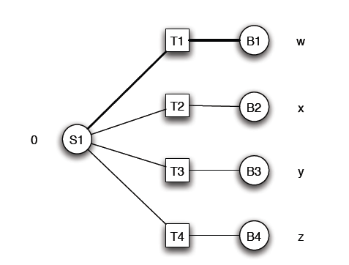
A single Action as a trading network with Intermediaries:
Let W>X>Y>Z
1. T1 Will do all possible pricing to make the deal. At worst T1 will ask X=W-X to make no profit. Therefore, Seller will receive x.
2. Buyer will pay the second highest bid of x
3. B₁ Will get the good.

Slide 23
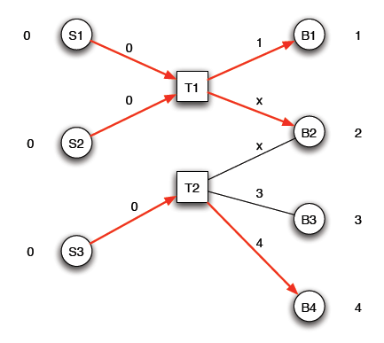
Ripple effect of a new link addition:
Consider this Network:
T₂ has access to buyers who value the good highly(3&4)
T₂ access to seller is limited.
T₁ has access to two sellers and two low value
buyers.
S₁ , S_{2 ,}S₃ , and B_{1 ,} B_{2 ,} B₃ ,B₄ are monopolized.
Therefore their Payoffs are zero.
B₃ is indifferent (3=3).
B₂ asks X must be the some equilibrium 0<X<2.
To resolve indifference, B₂ buys from T_{1.}

Slide 24
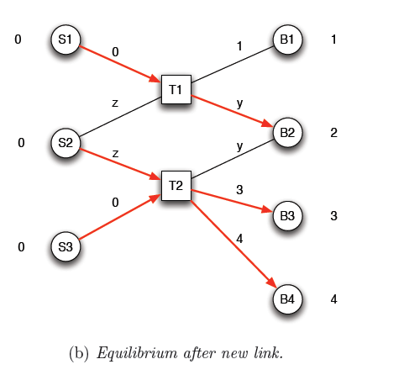
ADD A NEW LINK:
1.B₃ gets the good(3=3).
2. B₁ does not get the good. This is the first Ripple Effect.
3. B₂ is more powerful. This is the second ripple Effect.
4. 1<Y<2. Sell S₂ strengths benefits B_{2.}
5. Z must be the same for T₁ and T_{2.}
1 < Z < 3.
S₂ Will sell to T₂ since T₁ can pay at most 2.
T₂ buys from S₂ and S₃ and sells them to B₃
and B₄.
9. S₁ sells to B₂ through T_{1 .}

Slide 25
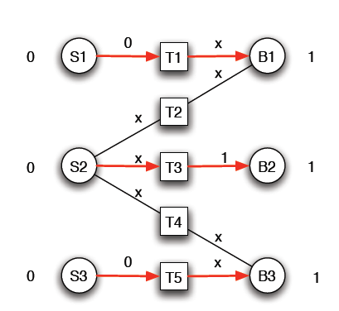
Social Welfare Option = Sum of all player Pay off one Optimized.
Social Welfare = ∑ (V_{j} - V_{i} ) ∀_{j} buyers and ∀_{I} sellers.
Social Welfare_{a} = 1+2+4 = 7.
Social Welfare_{b} = 2+3+4 = 9.
Traders:
If X=1 then traders T₁ and T₅ make profit.
If X=0 then only trader T₃ make profit.
Social Welfare = 3.

Slide 26
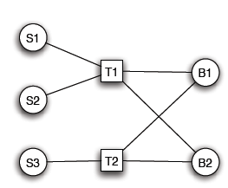
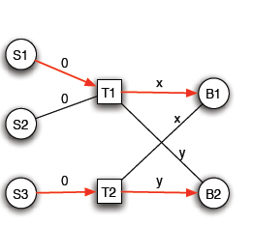
T₁ is essential profit = 0 in equilibrium.
T₁ trades one unit of good.

Slide 27
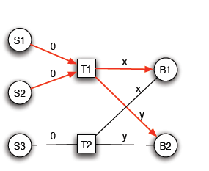
T₁ trades two visits of good.
Theorem:
An edge from a T to a buyer or seller is essential if by removal it changes social
welfare.

