Slide 1
Sorting Algorithms
CS 330 Intro to the Design and Analysis of Algorithms
Lecture note
Sajedul Talukder

Slide 2
Introduction
Common problem: sort a list of values, starting from lowest to highest.
List of exam scores
Words of dictionary in alphabetical order
Students names listed alphabetically
Student records sorted by ID#
Generally, we are given a list of records that have keys. These keys are used to define an ordering of the items in the list.

Slide 3
Sorting
To arrange a set of items in sequence.
It is estimated that 25~50% of all computing power is used for sorting activities.
Possible reasons:
Many applications require sorting;
Many applications perform sorting when they don't have to;
Many applications use inefficient sorting algorithms.

Slide 4
Sorting: The Big Picture
Horrible algorithms:
Ω(n²)
Simple
algorithms:
O(n²)
Fancier
algorithms:
O(n log n)
Bogo Sort
Stooge Sort
Comparison
lower bound:
Ω(n log n)
Insertion sort
Selection sort
Bubble Sort
Shell sort
…
Specialized
algorithms:
O(n)
Heap sort
Merge sort
Quick sort (avg)
…
Bucket sort
Radix sort

Slide 5
Quadratic Sorting Algorithms
We are given n records to sort.
There are a number of simple sorting algorithms whose worst and average case performance is quadratic O(n²):
Selection sort
Insertion sort
Bubble sort

Slide 6
Bubble Sort
Given n numbers to sort:
Repeat the following n-1 times:
For each pair of adjacent numbers:
If the number on the left is greater than the number on the right, swap them
How efficient is bubble sort?
In general, given n numbers to sort, it performs n² comparisons
The same as selection sort
Is there a simple way to improve on the basic bubble sort?
Yes! Stop after going through without making any swaps
This will only help some of the time

Slide 7
Bubble Sort
Bubble sort examines the array from start
to finish, comparing elements as it goes.
Any time it finds a larger element before a smaller element, it swaps the two.
In this way, the larger elements are passed towards the end.
The largest element of the array therefore "bubbles" to the end of the array.
Then it repeats the process for the unsorted portion of the array until the whole array is sorted.

Slide 8
Bubble Sort
Search for adjacent pairs that are out of order.
Switch the out-of-order keys.
Repeat this n-1 times.
After the first iteration, the last key is guaranteed to be the largest.
If no switches are done in an iteration, we can stop.

Slide 9
N-1 Iteration
1 2 3 4 5 6
42
35
12
77
5
101
1 2 3 4 5 6
35
12
42
5
77
101
1 2 3 4 5 6
N - 1
12
35
5
42
77
101
1 2 3 4 5 6
12
5
35
42
77
101
1 2 3 4 5 6
5
12
35
42
77
101

Slide 10
Reducing the Number of Comparisons
1 2 3 4 5 6
77
42
35
12
101
5
1 2 3 4 5 6
42
35
12
77
5
101
1 2 3 4 5 6
35
12
42
5
77
101
1 2 3 4 5 6
12
35
5
42
77
101
1 2 3 4 5 6
12
5
35
42
77
101

Slide 11
Reducing the Number of Comparisons
On the N^{th} “bubble up”, we only need to do MAX-N comparisons.
For example:
This is the 4th “bubble up”
MAX is 6
Thus we have 2 comparisons to do
1 2 3 4 5 6
12
35
5
42
77
101

Slide 12
Bubble Sort
void bubbleSort(int arr[])
{
int n = arr.length;
for (int i = 0; i < n-1; i++)
for (int j = 0; j < n-i-1; j++)
if (arr[j] > arr[j+1])
{
// swap arr[j+1] and arr[j]
int temp = arr[j];
arr[j] = arr[j+1];
arr[j+1] = temp;
}
}
To do N-1 iterations
To bubble a value
Inner loop
Outer loop

Slide 13
Bubble Sort Time Complexity
Best-Case Time Complexity
The scenario under which the algorithm will do the least amount of work (finish the fastest)
Worst-Case Time Complexity
The scenario under which the algorithm will do the largest amount of work (finish the slowest)

Slide 14
Bubble Sort Time Complexity
Called Linear Time
O(N)
Order-of-N
Best-Case Time Complexity
Array is already sorted
Need 1 iteration with (N-1) comparisons
Worst-Case Time Complexity
Need N-1 iterations
(N-1) + (N-2) + (N-3) + …. + (1) = (N-1)* N / 2
Called Quadratic Time
O(N²)
Order-of-N-square

Slide 15
Selection sort
selection sort: orders a list of values by repetitively putting a particular value into its final position
more specifically:
find the smallest value in the list
switch it with the value in the first position
find the next smallest value in the list
switch it with the value in the second position
repeat until all values are in their proper places

Slide 16
Selection Sort
12
6
8
22
22
14
22
17
12
12
6
8
12
14
14
17
22
17
17
22
22
Given n numbers to sort:
Repeat the following n-1 times:
Mark the first unsorted number
Find the smallest unsorted number
Swap the marked and smallest numbers

Slide 17
Selection Sort
Given n numbers to sort:
Repeat the following n-1 times:
Mark the first unsorted number
Find the smallest unsorted number
Swap the marked and smallest numbers
How efficient is selection sort?
In general, given n numbers to sort, it performs n² comparisons
Why might selection sort be a good choice?
Simple to write code
Intuitive

Slide 18
Selection Sort
while some elements unsorted:
Find the smallest element in the unsorted section; this requires all of the unsorted items to be compared to find the smallest
Swap the smallest element with the first (left-most) element in the unsorted section
smallest so far:
45
36
22
13
16
21
45
22
79
47
60
74
36
66
94
22
45
57
38
29
81
the fourth iteration of this loop is shown here

Slide 19
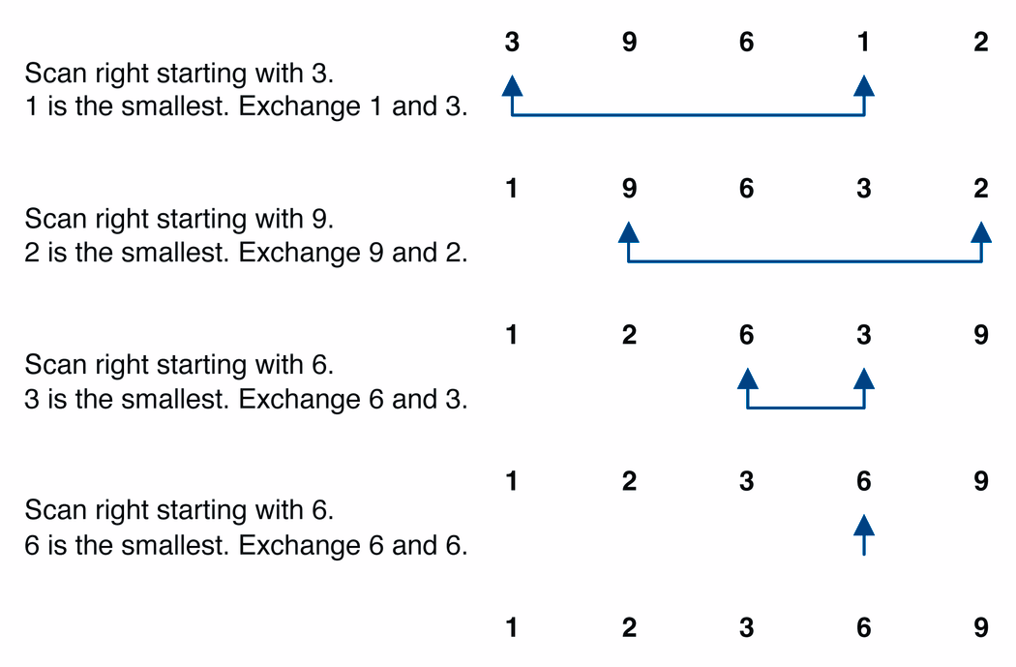
Selection sort example

Slide 20
Selection Sort Algorithm
public void selectionSort(Comparable[] arr) {
for (int i = 0; i < arr.length-1; ++i) {
int smallest = i;
// Find the index of the smallest element
for (int j = i + 1; j < arr.length; ++j) {
if (arr[j].compareTo(arr[smallest])<0) {
smallest = j;
}
}
// Swap the smallest with the current item
Comparable temp = arr[i];
arr[i] = arr[smallest];
arr[smallest] = temp;
}
}

Slide 21
Selection Sort: Number of Comparisons
Elements in unsorted | Comparisons to find min
n | n-1
n-1 | n-2
… | …
3 | 2
2 | 1
1 | 0
 | n(n-1)/2

Slide 22
Selection Sort: Analysis
Number of comparisons:
(n-1) + (n-2) + ... + 3 + 2 + 1 =
n * (n-1)/2 =
(n² - n )/2
→ O(n²)
Number of exchanges (worst case):
n – 1
O(n)
Overall (worst case) O(n) + O(n²) = O(n²) (‘quadratic sort‘)

Slide 23
Selection Sort Analysis
public void selectionSort(Comparable[] arr) {
for (int i = 0; i < arr.length-1; ++i) {
// outer for loop is evaluated n-1 times
int smallest = i; //n-1 times again
for (int j = i + 1; j < arr.length; ++j) {
// evaluated n(n-1)/2 times
if (arr[j].compareTo(arr[smallest])<0) {
// n(n-1)/2 comparisons
smallest = j; //how many times? (*)
}
}
Comparable temp = arr[i]; //n-1 times
arr[i] = arr[smallest]; //n-1 times
arr[smallest] = temp; //n-1 times
}
}

Slide 24
Insertion Sort
Simple sorting algorithm that works the way we naturally sort playing cards in our hands.
While some elements unsorted:
Using linear search, find the location in the sorted portion where the 1st element of the unsorted portion should be inserted
Move all the elements after the insertion location up one position to make space for the new element

Slide 25
Insertion Sort
insertion sort: orders a list of values by repetitively inserting a particular value into a sorted subset of the list
more specifically:
consider the first item to be a sorted sublist of length 1
insert the second item into the sorted sublist, shifting the first item if needed
insert the third item into the sorted sublist, shifting the other items as needed
repeat until all values have been inserted into their proper positions

Slide 26
Insertion Sort
Simple sorting algorithm.
n-1 passes over the array
At the end of pass i, the elements that occupied A[0]…A[i] originally are still in those spots and in sorted order.
2 | 15 | 8 | 1 | 17 | 10 | 12 | 5
0 | 1 | 2 | 3 | 4 | 5 | 6 | 7
after
pass 2
2 | 8 | 15 | 1 | 17 | 10 | 12 | 5
0 | 1 | 2 | 3 | 4 | 5 | 6 | 7
after
pass 3
1 | 2 | 8 | 15 | 17 | 10 | 12 | 5
0 | 1 | 2 | 3 | 4 | 5 | 6 | 7

Slide 27
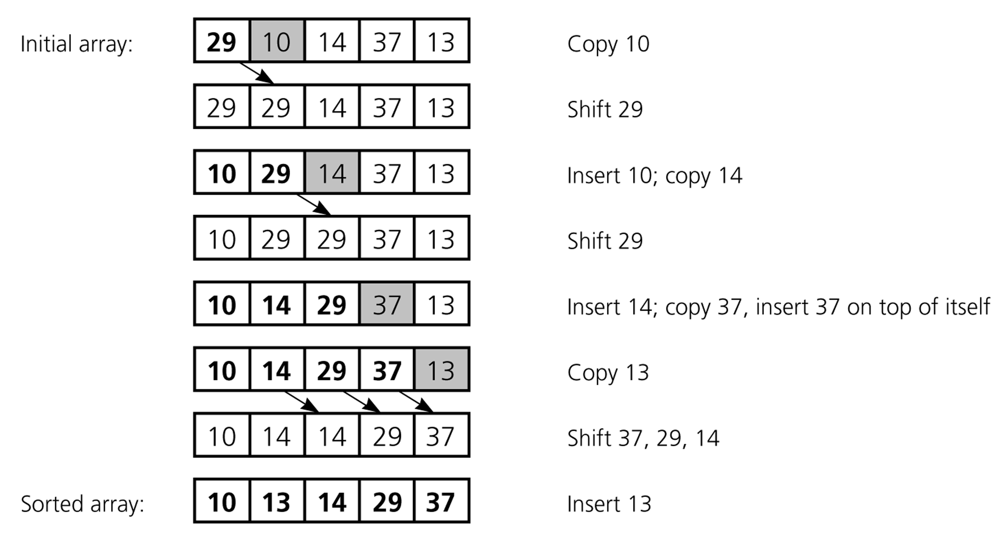
Insertion Sort

Slide 28
Insertion Sort Code
void sort(int arr[])
{
int n = arr.length;
for (int i=1; i<n; ++i)
{
int key = arr[i];
int j = i-1;
/* Move elements of arr[0..i-1], that are
greater than key, to one position ahead
of their current position */
while (j>=0 && arr[j] > key)
{
arr[j+1] = arr[j];
j = j-1;
}
arr[j+1] = key;
}
}

Slide 29
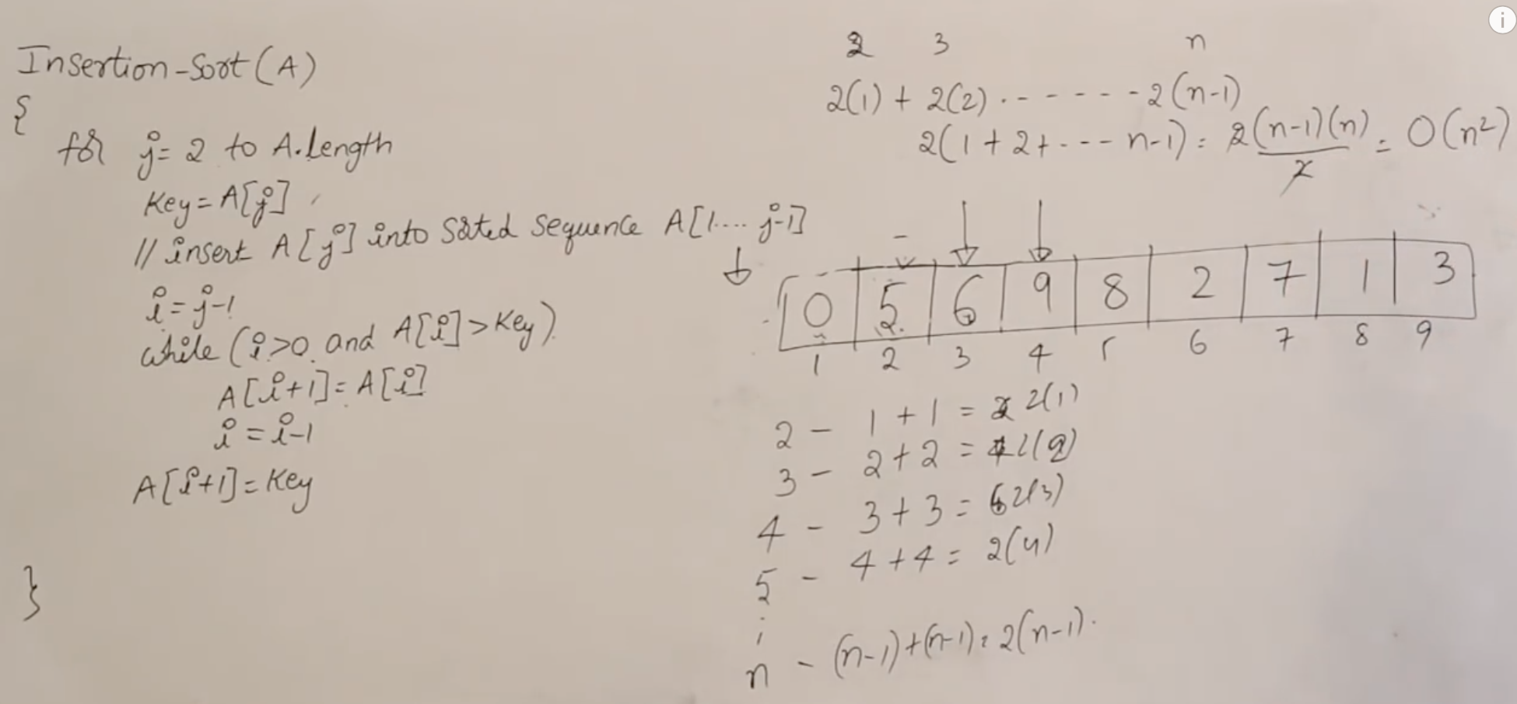
Insertion Sort Complexity
How many compares are done?
1+2+…+(n-1), O(n2) worst case
(n-1)* 1 , O(n) best case
How many element shifts are done?
1+2+...+(n-1), O(n2) worst case
0 , O(1) best case
How much space?
In-place algorithm
Best Case: O(n), if given in sorted order.
Worst Case: O(n^2), if given in reverse order.
Average Case: O(n^2), still a quadratic running time.

Slide 30
Insertion Sort: Analysis
Number of comparisons (worst case):
(n-1) + (n-2) + ... + 3 + 2 + 1 → O(n²)
Number of comparisons (best case):
n –1 → O(n)
Number of exchanges (worst case):
(n-1) + (n-2) + ... + 3 + 2 + 1 → O(n²)
Number of exchanges (best case):
0 → O(1)
Overall worst case: O(n²) + O(n²) = O(n²)

